Slide 1
Self Driving Lane Detection with Carla, ROS and Lanenet
CMPE 249
Systems Track
Adam Goldstein

Slide 2
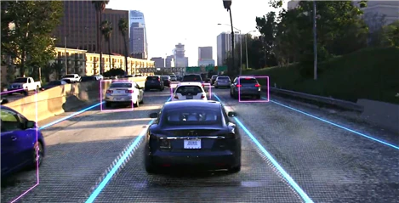
Project Overview
Lane detection is a critical aspect of Autonomous Driving
In a true self driving car, many sensors are used to perform lane detection
This project explores lane detection using solely a front facing RGB camera
Training data extracted from Carla simulator
Objective: Deploy a lane inferencing module from ROS to be used with the Carla simulator

Slide 3
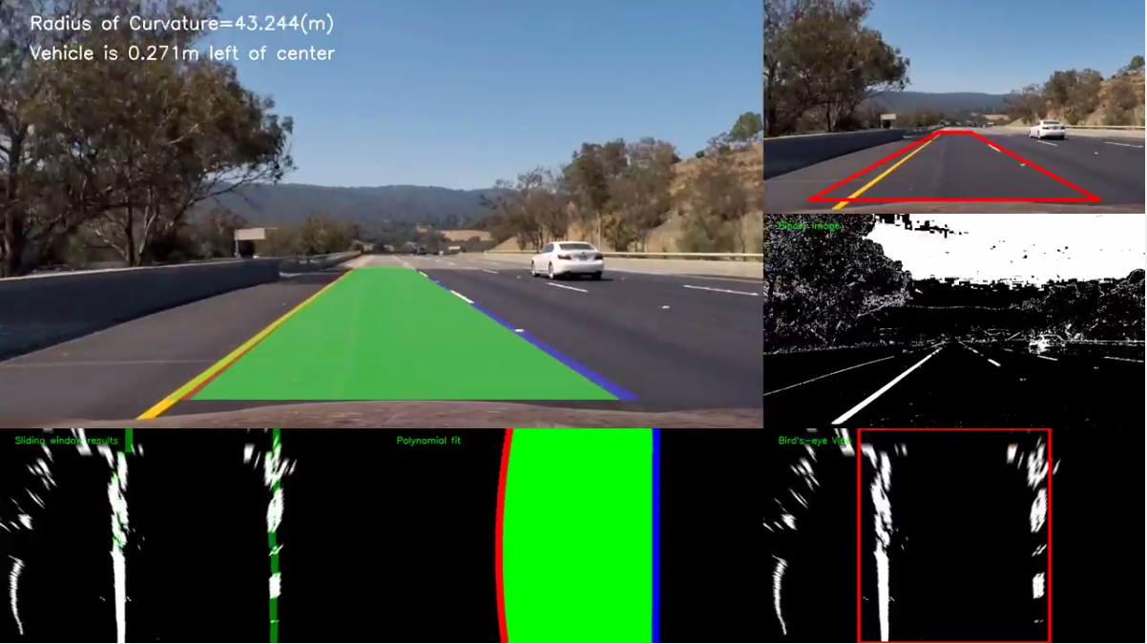
Existing work
Carla and ROS are open source
Many autonomous driving projects performed in Carla and ROS
Carla Contains built in lane detection feature
Many types of CNN based lane detection frameworks
Possible to perform lane detection simply with image processing in opencv with Hough Transform
Notes:
Hough transform is a computer vision technique used for the purpose of feature isolation of particular shapes in images and videos i.e. it is a technique that can be successfully used to identify specific shapes in images – e.g. lines, circles, ellipses, etc. However, the trivial and original implementation of Hough Transform deals with detecting straight lines.

Slide 4
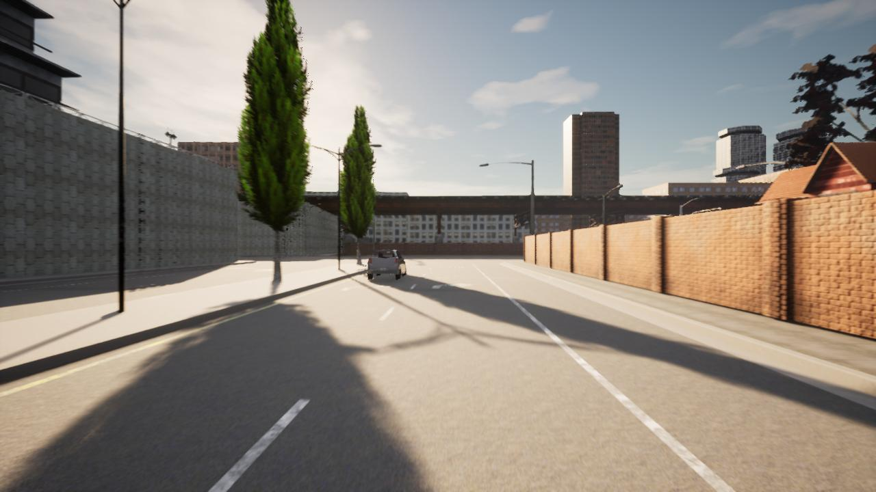
Data collection
Collected driving data with Carla 0.910 in Windows
Used python files from this repo to collect discrete driving inside Carla
Modified the files to only use one driving scene and weather condition for collection
Total of 5000 RGB images from front facing camera
Car driven in autonomous mode

Slide 5
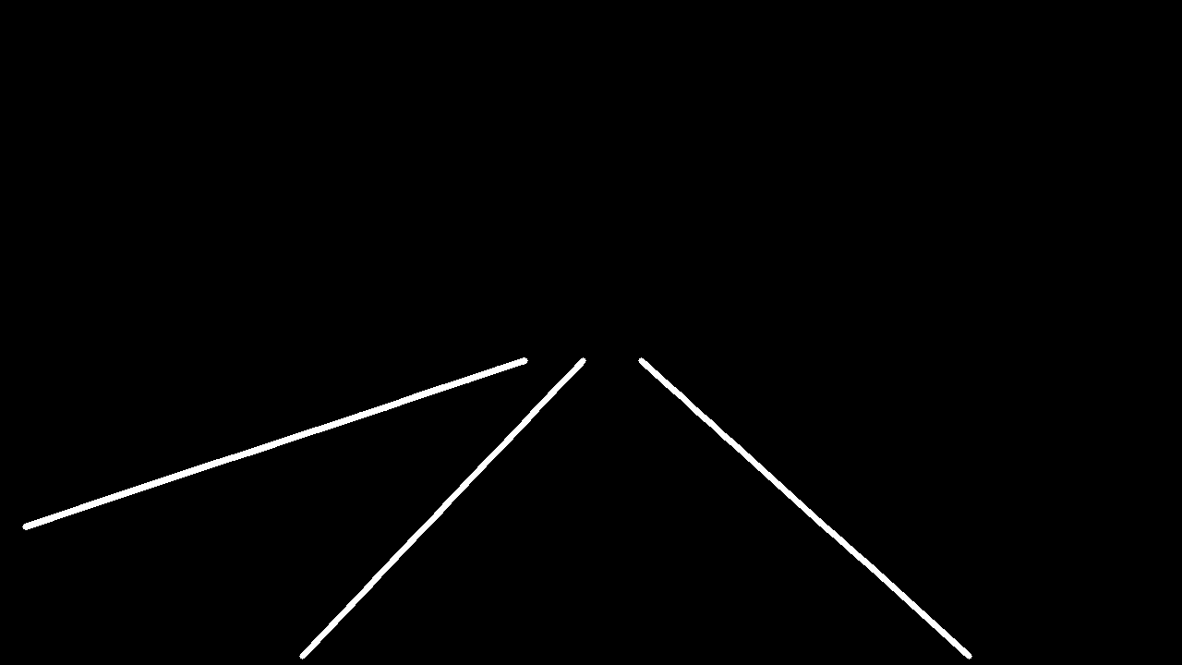
Image processing
To generate training labels performed image processing in opencv
Required “binary mask image” for model label
OpenCV grayscaling, thresholding, contour and edge detection
Binarized images to single channel (0,255) two class arrays

Slide 6
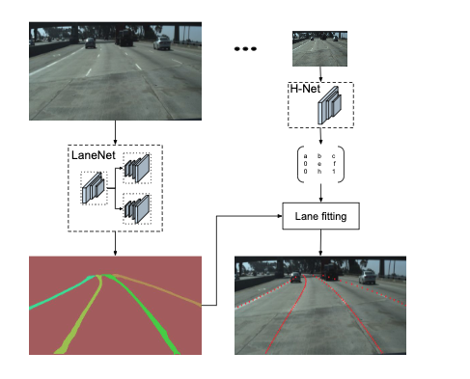
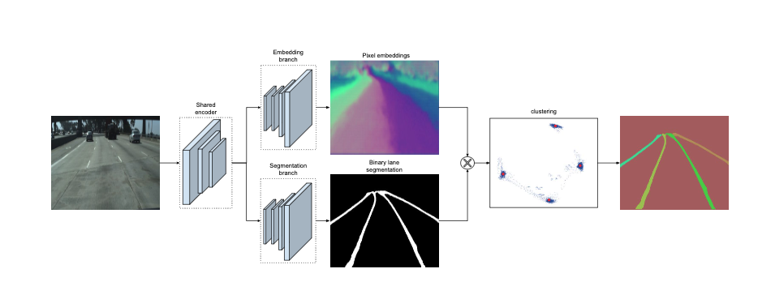
Model Selection
Performed literature search to ultimately select Towards End-to-End Lane Detection: An Instance Segmentation Approach as the model
Unsure how model would perform on simulated driving data
Architecture consists of two branches
Segmentation branch for binary mask
Embedding branch generates N dimensional embeddings
Notes:
System overview. Given an input image, LaneNet outputs a lane
instance map, by labeling each lane pixel with a lane id. Next, the lane
pixels are transformed using the transformation matrix, outputted by H-Net
which learns a perspective transformation conditioned on the input image.
For each lane a 3rd order polynomial is fitted and the lanes are reprojected
onto the image
LaneNet architecture. It consists of two branches. The segmentation branch (bottom) is trained to produce a binary lane mask. The embedding
branch (top) generates an N-dimensional embedding per lane pixel, so that embeddings from the same lane are close together and those from different
lanes are far in the manifold. For simplicity we show a 2-dimensional embedding per pixel, which is visualized both as a color map (all pixels) and as
points (only lane pixels) in a xy grid. After masking out the background pixels using the binary segmentation map from the segmentation branch, the lane
embeddings (blue dots) are clustered together and assigned to their cluster centers (red dots).

Slide 7
Model Training
Model Parameters
Batch Size | 32
Learning Rate | 0.001
Crop Size | 512x256
Num Classes | 2
Num Epochs | 100
Solver Type | Cross Entropy
GPU Acceleration | No
Evaluation Type | Mean Intersection Over Union
Trained model for 100 epochs
Ultimately converged on an IOU score of 0.613
Binary segmentation loss of 0.17
Mean inference time of 0.065s per image
Most likely fast enough for real time lane inferencing

Slide 8
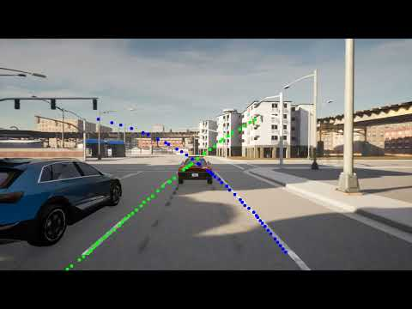
Model Results
Tested on separately extracted and processed Carla driving data
Model performed well on curved roadways
Darker conditions -> lane marker jumps around in unpredictable fashion
Difficult to distinguish driving lane to lane parallel

Slide 9
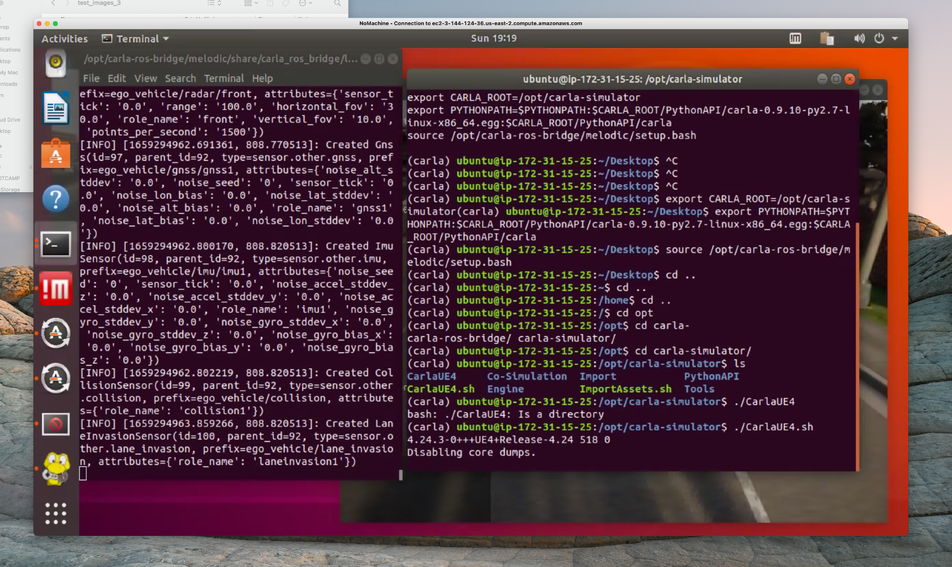
Carla ROS Bridge
Ultimate goal is to deploy real time lane detection as a ROS Node with Carla
Not fully functional yet
Installed ROS Melodic and Carla 0.97 on an AWS GPU enabled EC2 Ubuntu 18.04 instance
Installed NoMachine to get a desktop UI with VM
Installed Carla ROS Bridge to continuously communicate with the Carla server for manual control

Slide 10
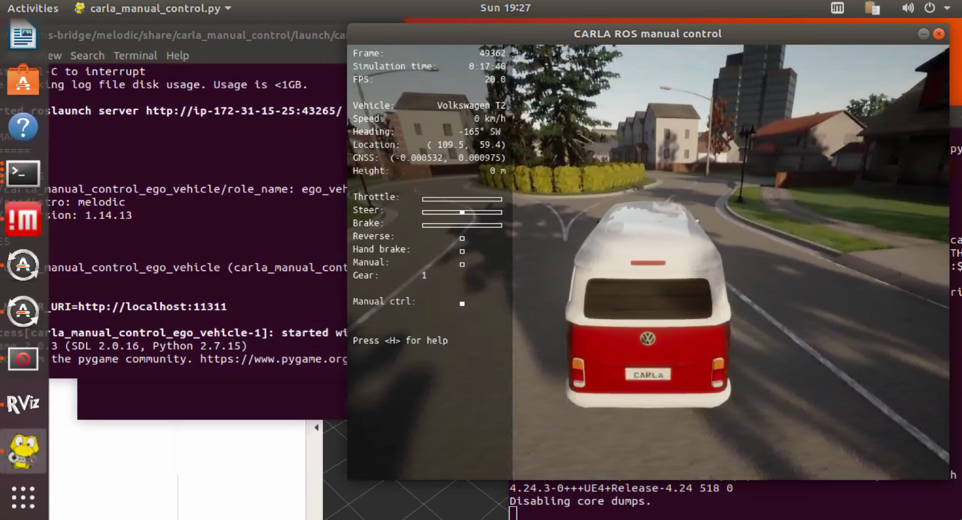
Working with Carla ROS Bridge inside EC2 Instance
Utilized synchronous mode to control ego vehicle, get subscriptions, publications and services
ROS gets all sensor data from each frame hosted on the Carla server
Carla was extremely laggy when running as a server node inside the instance
For this reason I selected to collect the driving data in windows

Slide 11
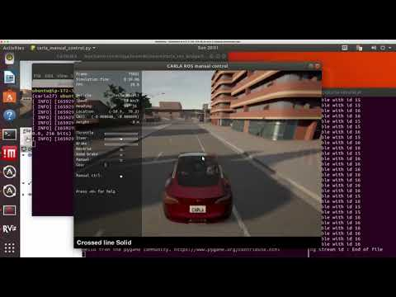
AWS EC2 Carla ROS manual control demo
If time permits, demonstration will be shown in realtime

Slide 12
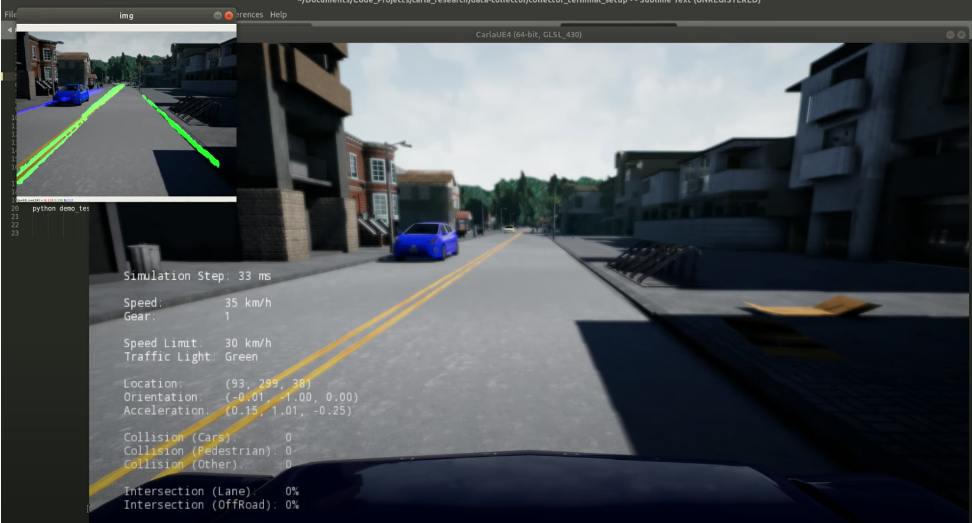
Next Steps
Modify ROS Bridge to collect sensor from Carla published as a ROS topic
For each image extracted from front facing camera, perform lane inference in real time
Similar to example shown to the right

Slide 13
Questions

Slide 14
References
(GitHub - MaybeShewill-CV/lanenet-lane-detection: Unofficial implemention of lanenet model for real time lane detection using deep neural network model https://maybeshewill-cv.github.io/lanenet-lane-detection/, 2022)
(GitHub - jbnunn/CARLADesktop: Run CARLA on an EC2 VM, 2022)
(GitHub - Glutamat42/Carla-Lane-Detection-Dataset-Generation: Create a dataset to train a lane detection neural network with CARLA, 2022)
(CARLA Manual Control - CARLA Simulator, 2022)
Neven, D., De Brabandere, B., Georgoulis, S., Proesmans, M. and Van Gool, L., 2022. Towards End-to-End Lane Detection: an Instance Segmentation Approach. [online] arXiv.org. Available at: <https://arxiv.org/abs/1802.05591> [Accessed 31 July 2022].
Medium. 2022. Implementing Lane Detection in CARLA using LaneNet. [online] Available at: <https://medium.com/@diazoangga/implementing-lane-detection-in-carla-using-lanenet-330d8fd8720c> [Accessed 31 July 2022
https://www.youtube.com/watch?v=47nwbZrG-aU

Slide 15
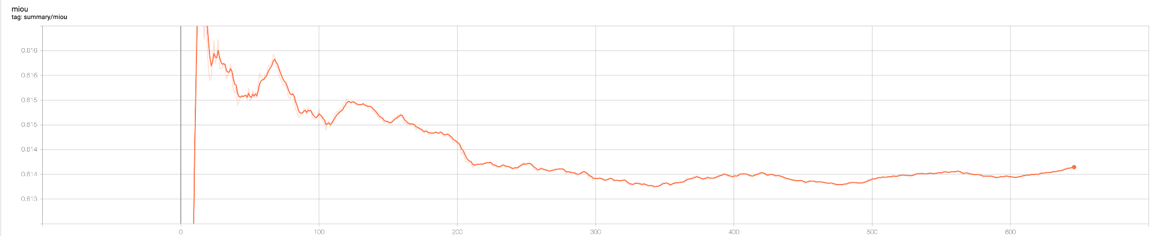
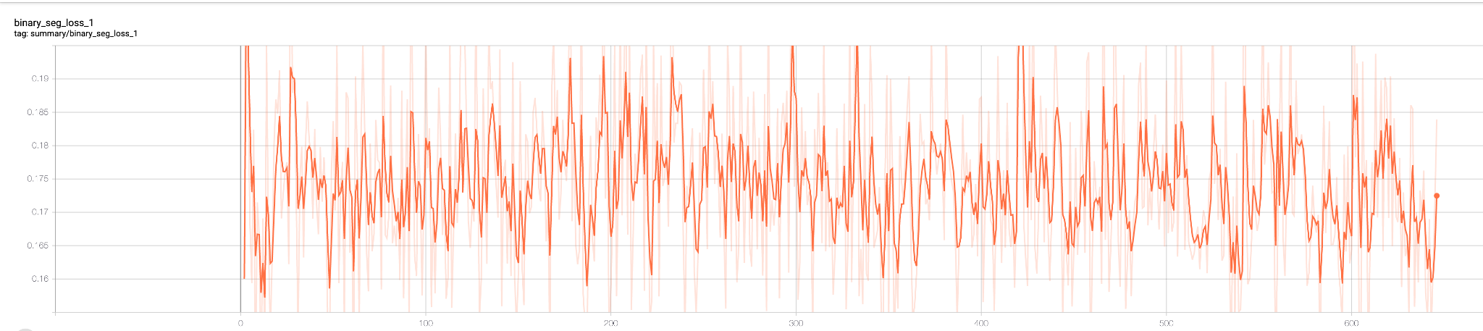
Appendix

Slide 16
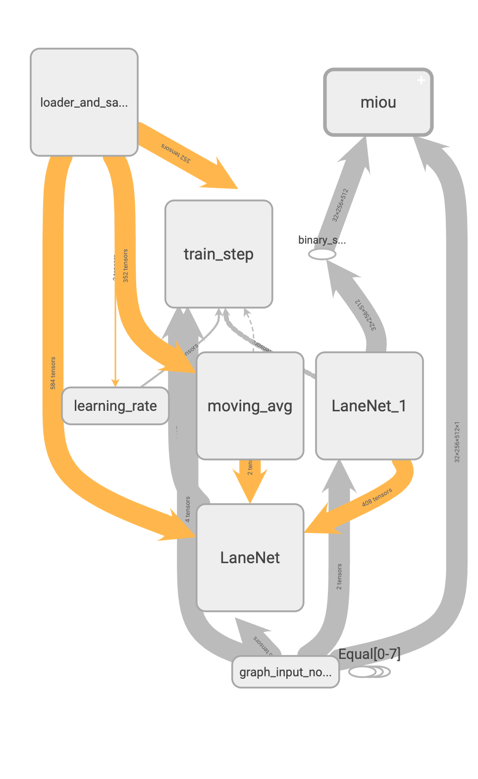
Appendix

